Slide 1



MARKETING ASSETS
ALR Jorge Martin Images Submission
All Sponsors have approved the release of these images for Global Marketing Purposes
Available for 2022 Season
9 Mar 2022

Slide 2
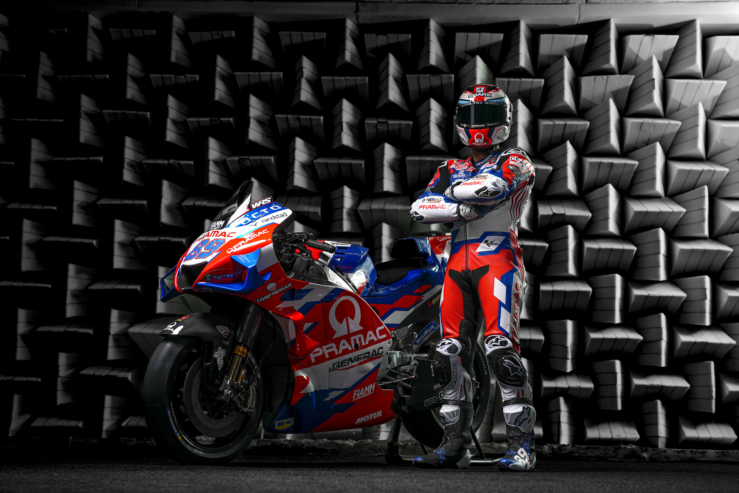

Slide 3
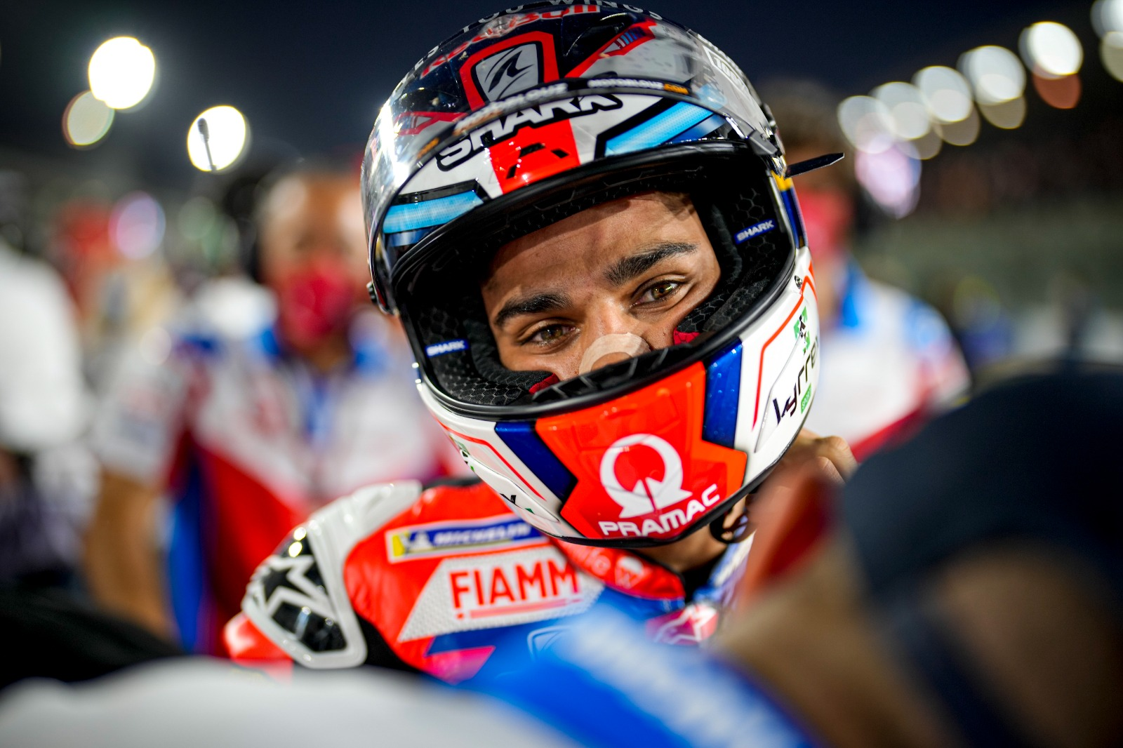

Slide 4
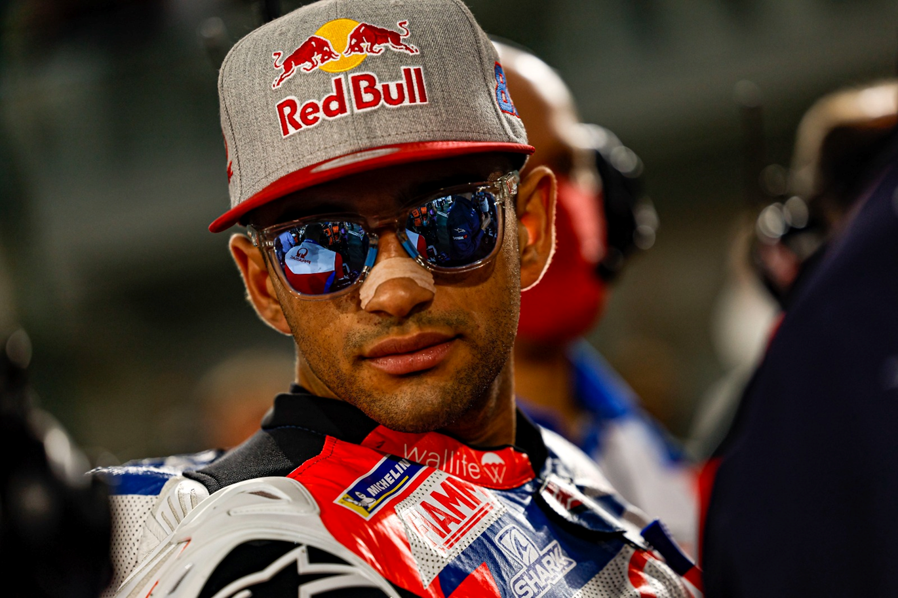

Slide 5
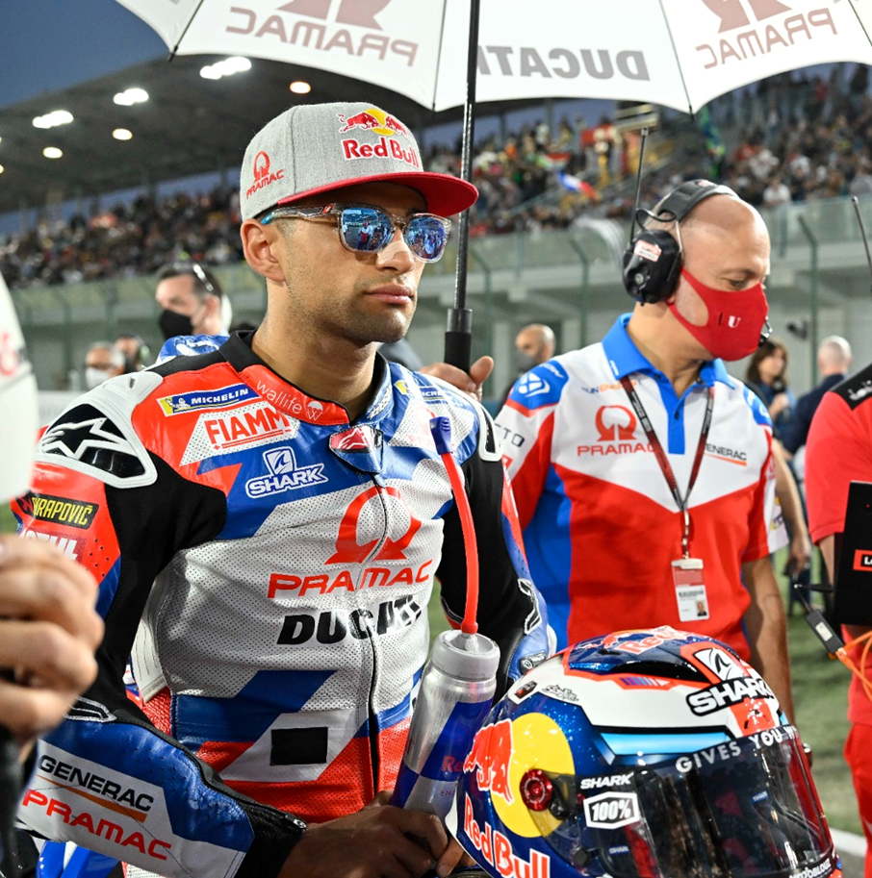
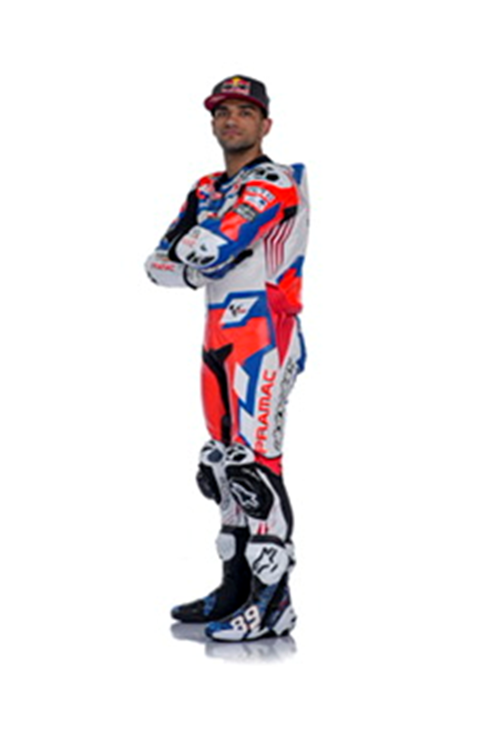
High Res Image Coming

