Slide 1
Educational Presentation

Slide 2

A Global Brand
Creating a Global Brand Identity for 2025 and beyond, the new logo delivers a true Global Experience for our customers, wherever they may be.
The new Logo uses a bold and contemporary font helping strengthen our brand offering, whilst the removal of the lozenge helps deliver a fresh, open feeling.
The 'Gradated Breather', crossing the ‘t’ in Breathe, deploys a subliminal message to the consumer that our products will help them breathe in more air.

Slide 3
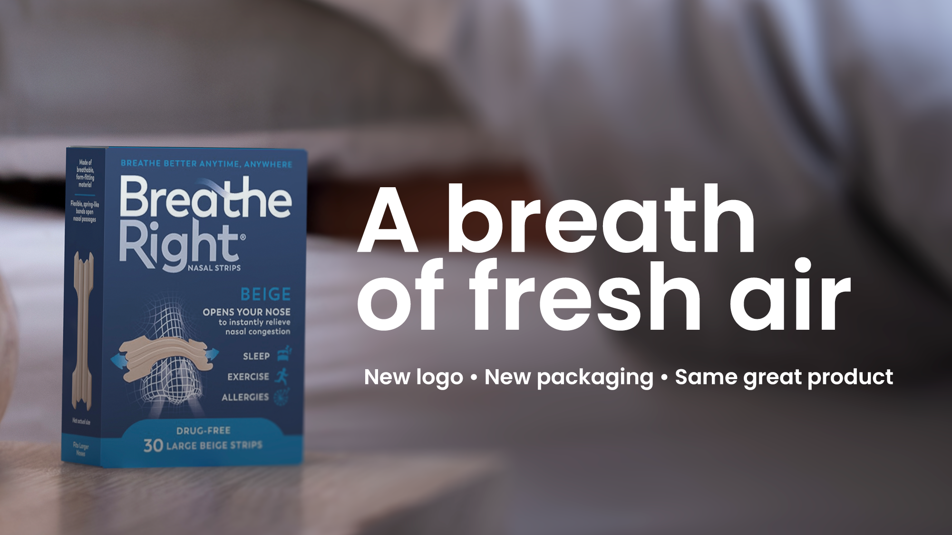

Slide 4
Opens the nose, to breathe more easily
Breathe Right® Nasal Strips open your nose so that you can take in air more easily.
Giving you more opportunities to breathe more comfortably – wherever you are.

Slide 5






Why Breathe Right® Nasal Strips
Opens the nose so you can take in air more easily and breathe more comfortably, especially when suffering from nasal congestion
Opens the nose to breathe more easily
Helps you take in air more easily and breathe more comfortably
Can be used day or night
Drug Free
Can be worn up to 12 hours
Helps relieve Night-time nasal congestion

Slide 6

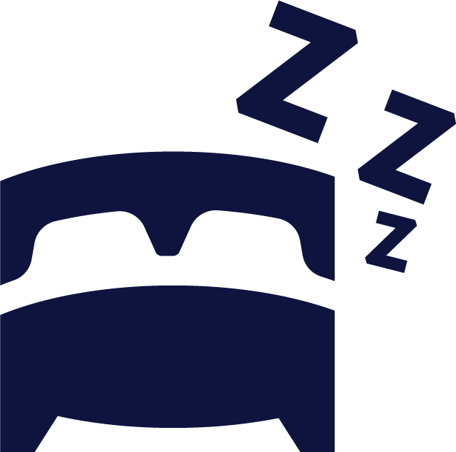







Relief You Can Feel Instantly
When suffering from nasal congestion
Night Time
Nasal Congestion
Snoring due to Night-time Nasal Congestion
Nasal Congestion due to a Deviated Septum
Nasal Congestion
due to a cold
Nasal Congestion
due to allergies
For Health &
Wellbeing
Mindfulness
& Relaxation
Exercise
& Sport
Focus & Concentration
Instantly relieves
night-time nasal congestion to help you sleep better
Reduces snoring due to nasal congestion
Helps relieve nasal congestion due to a deviated septum to breathe more easily
Opens the nose to relieve nasal congestion due to a cold
Relief from
nasal congestion you can feel instantly
Opens the nose so you can take in air more easily and breathe more comfortably
Opens the nose to breathe more easily
Opens the nose to breathe more easily
Opens the nose to breathe more easily

Slide 7



How it works
Breathe more easily - wherever you are

Slide 8
What are Breathe Right® Nasal Strips?
Breathe Right® Nasal Strips are flexible spring-like bands that gently lift & open your nose/nostrils for improved nasal airflow helping you breathe more easily.
Breathe Right ® Strips instantly relieves nasal congestion that can arise from colds, allergies & a deviated septum and are clinically shown to help reduce snoring for a better night’s sleep. They are drug free, so you can use Breathe Right® Nasal Strips alongside medicinal treatments and during pregnancy.
* Copy must be used as one text, do not extract segments for other use
How Breathe Right® Nasal Strips work *
Breathe Right ® Nasal Strips are a drug free, non-prescription device that works mechanically from the outside to gently open the nose/nostrils. This reduces nasal airflow resistance and makes breathing easier.
Breathe Right ® can be used anytime you want to breathe more easily through your nose. They relieve nasal congestion that can arise from colds, allergies, or a deviated septum and help reduce snoring for a better night’s sleep.
You can use them any time day or night for general wellbeing, when you are exercising or simply relaxing. They are gentle on skin and suitable for adults and children 6 years and over.

Slide 9
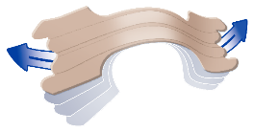


Breathe Right® Nasal Strips
Find Your Perfect Fit !
Breathe Right® Nasal Strips come in two different Materials;
Original Beige Fabric and Clear Substrate
Original Beige
suitable for normal to oily skin
Clear
suitable for sensitive or dry skin
Breathe Right® Original Beige Nasal Strips are suitable for normal to oily skins. With a breathable and form-fitting material that comfortably adheres these nasal strips consist of an overlay substrate material which is perforated.
The perforations allow air to both escape through the substrate and interact with the adhesive, so that they stay on whether using them at night or during intense activity.
Breathe Right ® Clear Nasal Strips are chosen by customers with a dry, sensitive or easily damaged skin, or who have a greater concern over the appearance of the strip.
These strips feature a hypoallergenic, flexible and non-porous overlay substrate which is not perforated, but a solid material. Because moisture is trapped under the strip the skin is occluded and this moist environment makes them easier to remove and suitable for dry or sensitive skin.
Product is wrapped in packaging that may have been in contact with latex during its manufacture

Slide 10
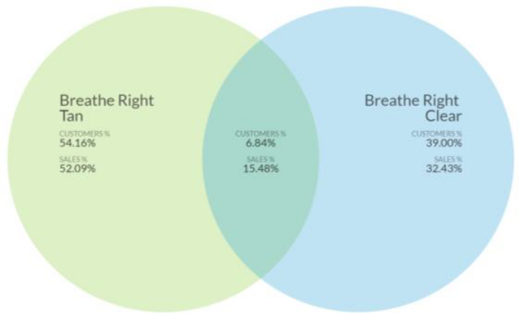
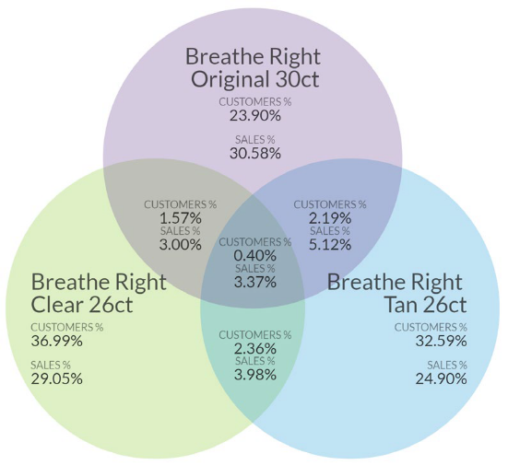
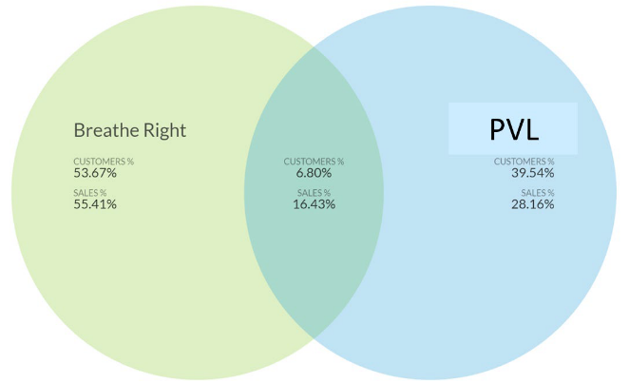
Breathe Right® Assortment is highly Incremental and Users are loyal
Additional SKU listing delivers incremental growth NOT cannibalisation
ONLY 7% OF SHOPPERS PURCHASE BOTH
BEIGE AND CLEAR
BREATHE RIGHT® USERS ARE LOYAL
ONLY 7% OF CUSTOMERS PURCHASED BOTH BREATHE RIGHT® AND PVL IN THE PAST YEAR
LESS THAN 3% OF SHOPPERS PURCHASE MULTIPLE STRIP TYPES
Consumers ‘find their perfect fit’
Introducing more SKUs
does NOT cannibalise sales
Why? Technical and performance differences between strip types drive consumer choice/loyalty
Tan strips provide a better user experience for those primarily concerned with stay on, use at night, and use during intense activity. Overlay substrate used on the beige strips is perforated. Perforations allow air to both escape through the substrate and interact with the adhesive.
Clear strips are chosen by those with sensitive or easily damaged skin or those who have greater concern over the appearance of the strip. Overlay substrate used on the clear strips is not perforated, it’s solid. Because moisture is trapped under the strip the skin is occluded –this moist environment leads to easier removal of the strip.
Source: US Consumer Survey, National Loyalty a Data Analysis - L52wks ending November 2022

Slide 11








Drug-Free and safe to use alongside medicinal treatments
Breathe Better
Sleep Better
Helps reduce snoring due to nasal congestion*
*Scharf et al. Ear, Nose, Throat Journal 1994 (Small, open label study in mild snorers).
Helps relieve night-time nasal congestion
Relieves nasal congestion caused by colds
Relieves nasal congestion
Breathe more comfortably
Breathe
more easily

Slide 12
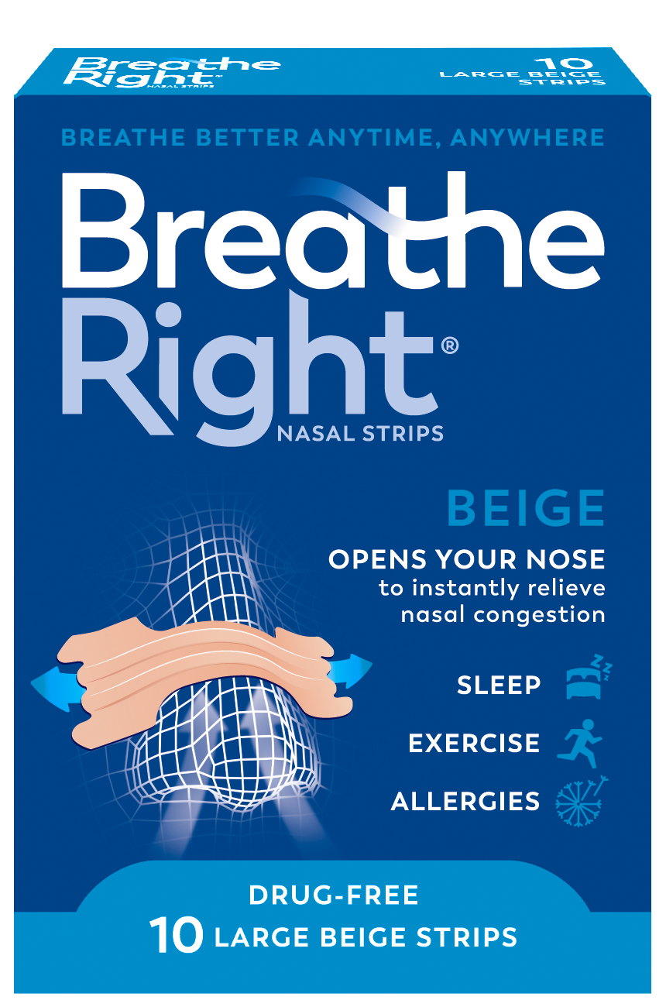
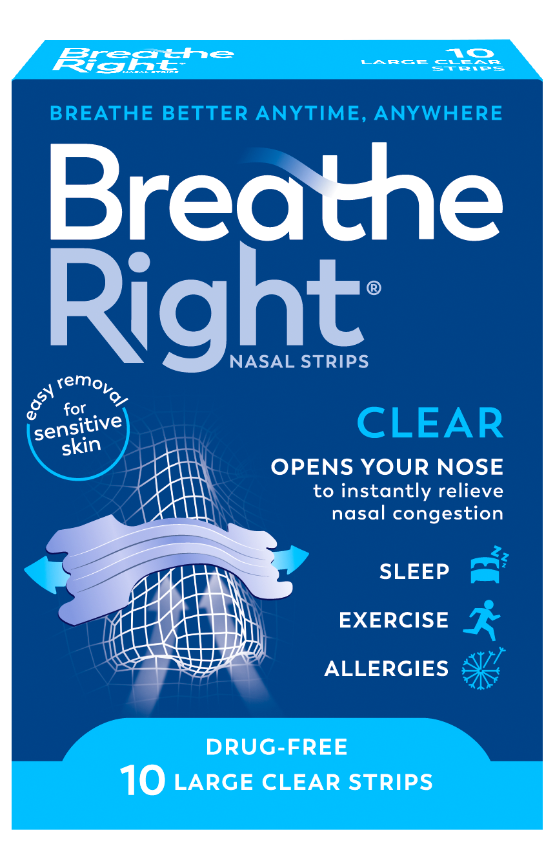
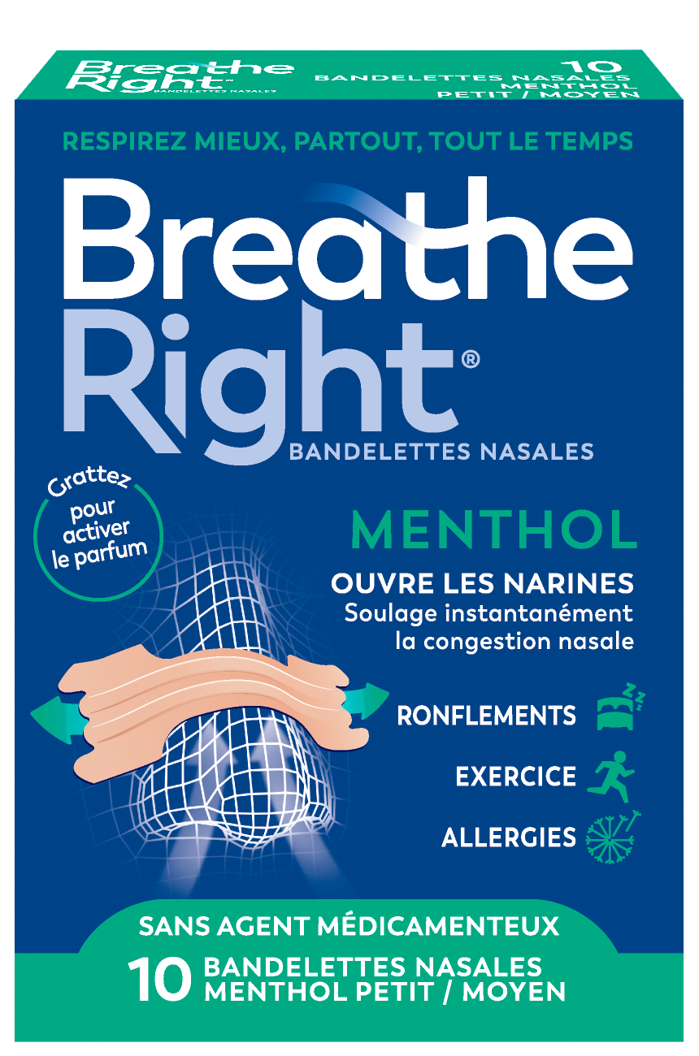
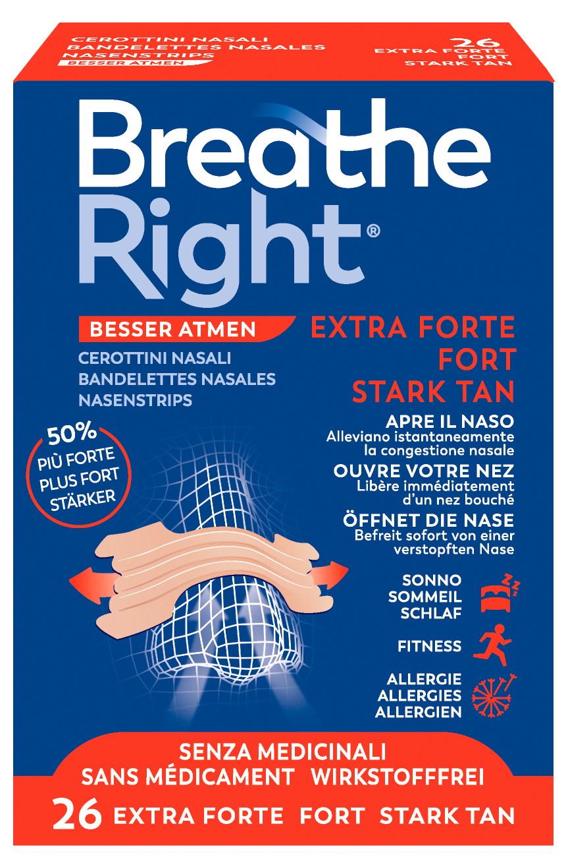
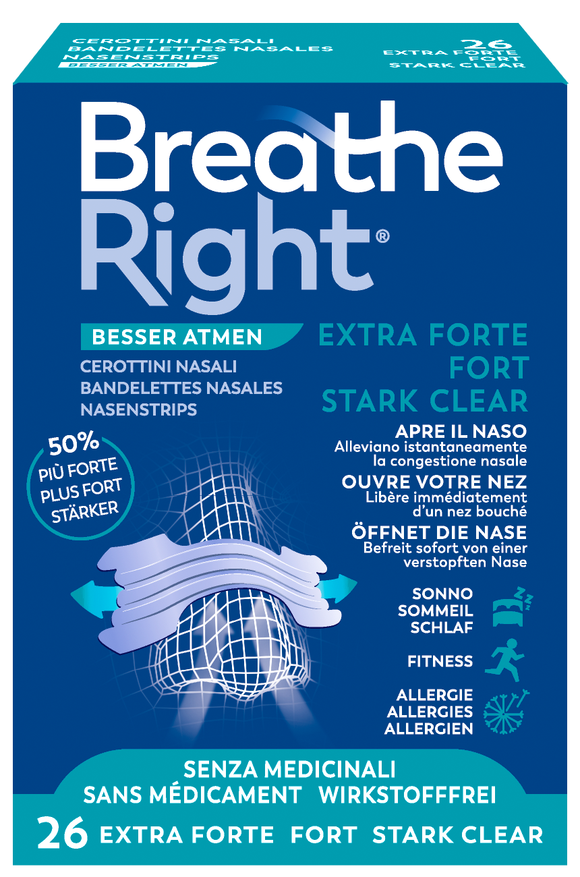

Our product range
(Not all formats are available in all markets)
Better breathing starts with us

Slide 13

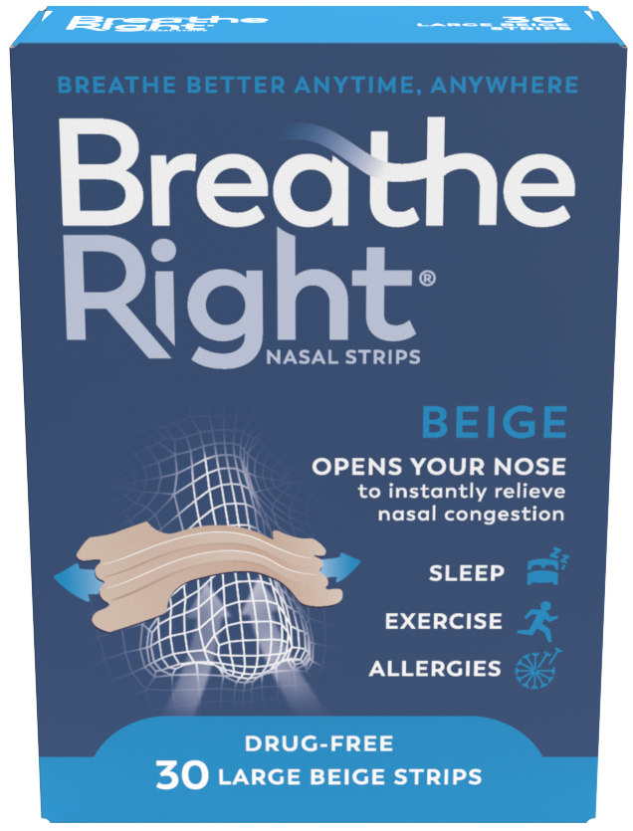

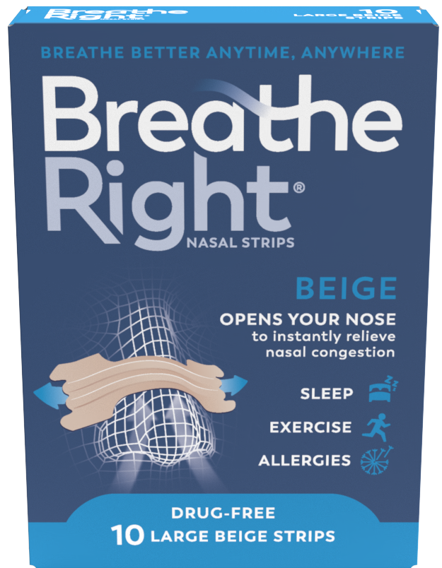
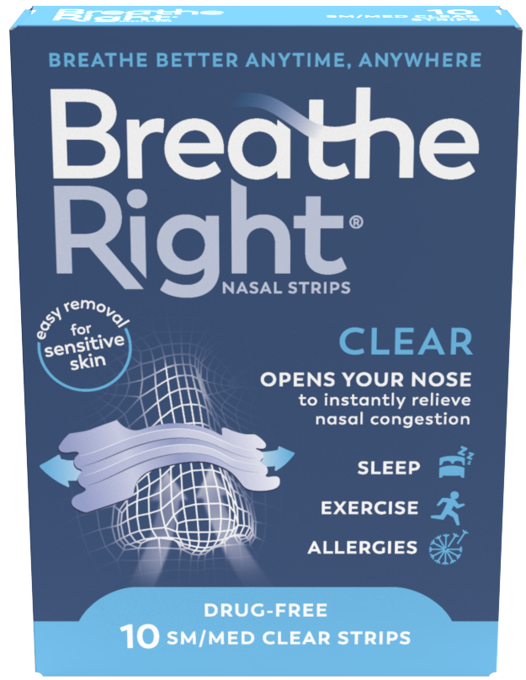

Display Your Own Market Portfolio
e.g. UK Market’s Product Portfolio shown here
Our UK product portfolio
Remove or add your own flag
Original Beige Large, 30s
Original Beige Small/Medium, 30s
Original Beige Large, 10s
Clear Transparent Small/Medium, 10s
Clear Transparent Large, 10s

Slide 14


BEIGE
Available in Packs of x30 strips or x10 strips
Available in Small/Medium and Large
Nasal Strips
Original, beige fabric
for normal to oily skins
Breathe Right® Original Nasal Strips are flexible spring-like bands that gently lift and open your nose for improved nasal airflow, helping you to breathe more easily.
Breathe Right® Original Nasal Strips instantly relieve nasal congestion that can arise from colds, allergies, or a deviated septum and help reduce snoring for a better night’s sleep.
For those with normal to oily skin, then our breathable and form-fitting material comfortably adheres, so that they stay on, whether using them at night, when you are exercising, for general wellbeing or simply relaxing.
Breathe Right® Original Nasal Strips are drug free and safe to use alongside medicinal treatments, during pregnancy and for children over 6 years.
Nighttime
Nasal Congestion
Snoring due to Night-time Nasal Congestion
Nasal Congestion
due to a cold
Nasal Congestion
due to allergies
Exercise
& Sport

Slide 15
CLEAR
Available in Packs of x30 strips or x10 strips
Available in Small/Medium and Large
Nasal Strips
Clear, transparent
for dry, sensitive skins
Breathe Right® Clear Nasal Strips are flexible spring-like bands that gently lift and open your nose for improved nasal airflow, helping you to breathe more easily.
Breathe Right® Clear Nasal Strips instantly relieve nasal congestion that can arise from colds, allergies & a deviated septum, and help reduce snoring for a better night’s sleep.
For those with dry or sensitive skins, or who have a greater concern over the appearance of the strip, our Clear Strips feature a hypoallergenic, flexible, and non-porous material that makes them easier to remove.
Breathe Right® Clear Nasal Strips open your nose so you can take in air more easily when suffering from nasal congestion, helping you to breathe more comfortably, so can be used at night, to reduce snoring, when you are exercising, for general wellbeing or simply relaxing.
Breathe Right® Clear Nasal Strips are drugfree and can be used alongside medicinal treatments, they are safe for use during pregnancy and for children over 6 years.
Nighttime
Nasal Congestion
Snoring due to Night-time Nasal Congestion
Nasal Congestion
due to a cold
Nasal Congestion
due to allergies
Exercise
& Sport

Slide 16
EXTRA STRENGTH BEIGE
Available in Packs of x26 Strips or 8 Strips
Available in One Size to fit most noses
Nasal Strips
Extra Strength, beige fabric
for normal to oily skins
Breathe Right® Extra Strength Beige Nasal Strips are flexible spring-like bands that gently lift & open your nose for improved airflow, helping you to breathe more easily. Breathe Right® instantly relieve nasal congestion that can arise from colds, allergies and a deviated septum.
For those with normal to oily skin, then our breathable and form fitting material comfortably adhere, so they stay on. Our Extra Strength Beige Nasal Strips have 50% more fabric and adhesion so are 50% stronger than standard beige strips and come in ONE SIZE to fit most noses.
Breathe Right® Extra Strength Beige Strips open your nose so you can take in air more easily when suffering from nasal congestion, helping you to breathe more comfortably, so can be used at night, to reduce snoring, when you are exercising, for general wellbeing or simply relaxing.
Breathe Right® Extra Strength Beige Nasal Strips are drug free and can be used alongside medicinal treatments, they are safe for use during pregnancy and for children over 6 years.
Nighttime
Nasal Congestion
Snoring due to Night-time Nasal Congestion
Nasal Congestion
due to a cold
Nasal Congestion
due to allergies
Exercise
& Sport

Slide 17
EXTRA STRENGTH CLEAR
Available in Packs of x26 Strips or x8 Strips
Available in One Size to fit most noses
Nasal Strips
Extra Strength, clear fabric
for dry sensitive skins
Breathe Right® Extra Strength Clear Nasal Strips are flexible spring-like bands that gently lift & open your nose for improved airflow, helping you to breathe more easily. Breathe Right® Extra Strength Clear Nasal Strips instantly relieve nasal congestion that can arise from colds, allergies and a deviated septum.
For those with dry or sensitive skins, or who have a greater concern over the appearance of the strip, our Clear Strips feature a hypoallergenic, flexible, and non-porous material that makes them easier to remove. Our Extra Strength Clear Nasal Strips have 50% more fabric and adhesion so are 50% stronger than standard beige strips and come in ONE SIZE to fit most noses.
Breathe Right® Extra Strength Clear Nasal Strips open your nose so you can take in air more easily when suffering from nasal congestion, helping you to breathe more comfortably, so can be used to reduce snoring, when you are exercising, for general wellbeing or simply relaxing.
Breathe Right® Extra Strength Clear Nasal Strips are drug free and can be used alongside medicinal treatments, they are safe for use during pregnancy and for children over 6 years.
Nighttime
Nasal Congestion
Snoring due to Night-time Nasal Congestion
Nasal Congestion
due to a cold
Nasal Congestion
due to allergies
Exercise
& Sport

Slide 18
MENTHOL
Available in Packs of x10 strips
Available in Small/Medium and Large
Nasal Strips
Menthol scented
for normal to oily skins
Breathe Right ® Menthol Nasal Strips are flexible spring-like bands that gently lift and open your nose for improved airflow, helping you to breathe more easily. Breathe Right ® Menthol Nasal Strips instantly relieve nasal congestion that can arise from colds, allergies and a deviated septum and help reduce snoring for a better night’s sleep.
Our breathable and form-fitting material comfortably adheres, so that they stay on, whether using them at night, when you are exercising, for general wellbeing or simply relaxing.
Breathe Right® Menthol Nasal Strips are coated with capsules that contain menthol, eucalyptus and camphor. Scratch the surface to release the soothing mentholated vapours - scratch again to reactivate.
Breathe Right® Menthol Nasal Strips are drug free and can be used alongside medicinal treatments, they are safe for use during pregnancy and for children over 6 years.
Nighttime
Nasal Congestion
Snoring due to Night-time Nasal Congestion
Nasal Congestion
due to a cold
Nasal Congestion
due to allergies
Exercise
& Sport

Slide 19

Breathe Right® Nasal Strips
Opens your nose to help you breathe more easily

Slide 20



Breathe Right® Nasal Strips
Breathe Right® Nasal Strips come in two different formats; Original Beige which is suitable for normal to oily skin and Clear Transparent, which are suitable for dry or sensitive skin.
Original Beige
suitable for normal to oily skin
Find your perfect fit
Original/Classic
Clear & Transparent
Suitable for normal & oily skin
Suitable for dry or sensitive skin
Relieves snoring due to nasal congestion
Relieves nasal congestion during exercise
Alleviates nasal congestion due to a deviated septum
Relieves nasal congestion due to allergies
Use up to 12 hours
Drug Free
Health & Wellness
Clear Transparent
suitable for sensitive or dry skin
With a breathable and form-fitting material that comfortably adheres, our Breathe Right® Original Nasal Strips can be used day or night for up to 12 hours.
Our Breathe Right® Clear strips feature a hypoallergenic, flexible and non-porous material that makes them easier to remove, making them suitable for dry or sensitive skin and can be worn day or night up to 12 hours.

Slide 21



Find Your Perfect Fit
All noses differ in size.
Choose between our Small/Medium, Large or Extra Strength nasal strips to find which works best for your nose and your skin.
Breathe Right ® Original Beige Nasal Strips
Small/Medium
Large
Extra Strength
5.5cm
6.5cm
6cm
5.0cm
5.6cm
5.5cm
Also available in Menthol​
For Markets with Beige, Small/Medium, Large & Extra
These are average product dimensions

Slide 22



Find Your Perfect Fit
All noses differ in size.
Choose between our Small/Medium, Large or Extra Strength nasal strips to find which works best for your nose and your skin.
Breathe Right ® Clear Transparent Nasal Strips
Small/Medium
Large
Extra Strength
5.5cm
6.5cm
6cm
5.0cm
5.6cm
5.5cm
For Markets with Clear, Small/Medium, Large & Extra
These are average product dimensions

Slide 23
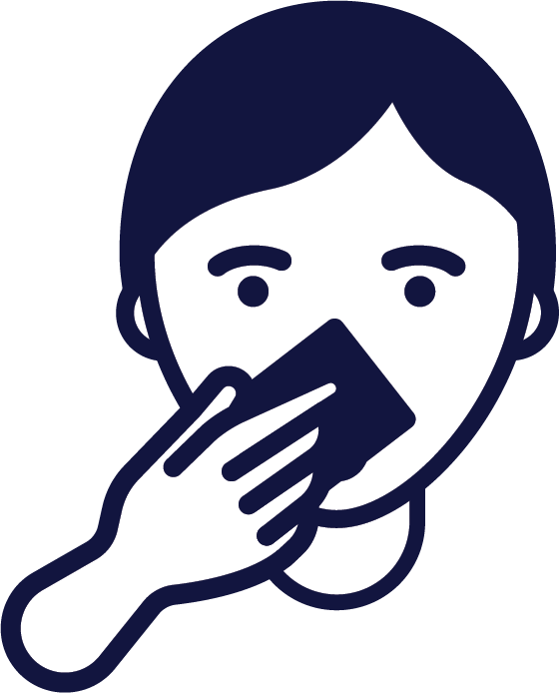

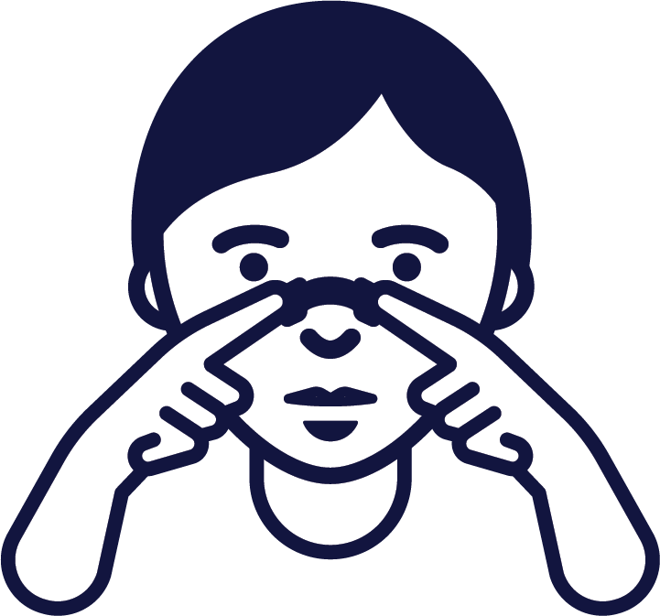
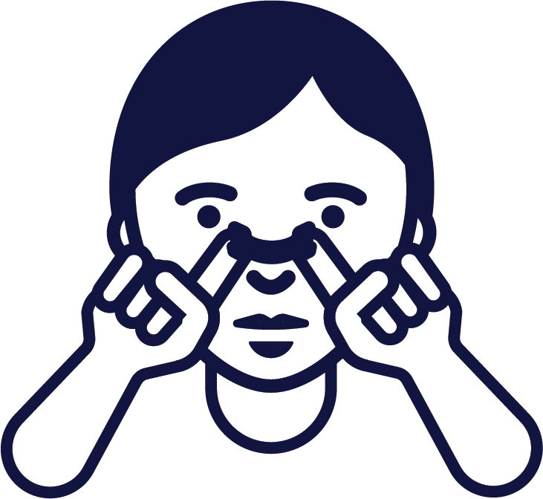

How to apply
Clean the Skin
The adhesive won’t stick properly to wet, oily or moisturised skin, so wash and dry your nose before applying.
Size matters
No, really. Our strips come in different sizes, and skin sensitivity levels, making it easy to determine which strip is best for you.
Position is everything
Place the adhesive
side of the strip right
above where your nose/nostril
flares out.
Breathe easy
Gently rub the strip to secure it into place on your nose. Take a deep breath. More comfortable breathing begins now.
To remove
Wash your face with warm water for 10 seconds, then gently lift each side of the strip and remove. Ta-da!

Slide 24




Technical information
Caution: Before using the product, read carefully the instructions for use enclosed in the package.
Do not use if package is damaged.
Single use: Nasal Strips are for single use.
Paper pouch around the strips may contain natural rubber latex.
DO NOT USE
If you are allergic to latex or Breathe Right Nasal Strips
Sleep Apnoea: Breathe Right Nasal Strips are not intended to treat Sleep Apnoea. Persons who have symptoms of Sleep Apnoea should consult their doctor.
Some people may experience adverse reactions when using breathe Right Nasal Strips. These may be application site reactions (e.g., erythema, irritation, pain, exfoliation, excoriation, bleeding, scab and discolouration) and hypersensitivity reaction including rash, pruritus and facial oedema.
How to store Breathe Right Nasal Strips
Do not store above 30 C.
Store in the original package. Please dispose of the product according to your local requirements and always consider the environment.
How to use Breathe Right Nasal Strips
Disposable –use each strip only once. For Single use only.
Can be used day or night.
Correct placement makes sure you get maximum performance. Be careful to place it neither too high nor too low.
Clean: Wash and dry your nose to remove dirt and oils. (For oily skin, use an astringent)
Place: remove the liner and place the strip on the nose.
Apply: Press down ends and rub gently to secure.
How to remove Breathe Right Nasal Strips
Remove your Breathe Right Nasal Strip while washing your face with warm water or when you’re in the shower.
Always remove the strip slowly.
Loosen the ends then gently lift the strip from both sides.
Remove your strip properly with water, to reduce the likelihood of skin reactions or injury.
Always use the product as described in the product information.
In case of any further concerns, please consult your pharmacist
or doctor for advice.
Warnings and Precautions
For external use only
Do not use over sores, sunburned or irritated skin
If rash or skin irritations occurs, discontinue use
Do not use for more than 12 hours per day
For performance reasons the strips are for single use only. After removal sticker loses stickiness and the strip will not remain in place
Warnings and Precautions
Keep the product out of sight and reach of children
Not for children 5 years of age
The paper pouch where the strips are packed may contain natural rubber latex which may cause allergic reactions
If in doubt about the use of this product, ask a healthcare professional.
Product is wrapped in packaging that may have been in contact with latex during its manufacture

Slide 25
Interested in stocking
Breathe Right®
Please contact us:
Add your Contact Information Here
www.breatheright.co.uk
Amend to your website address

