Slide 1
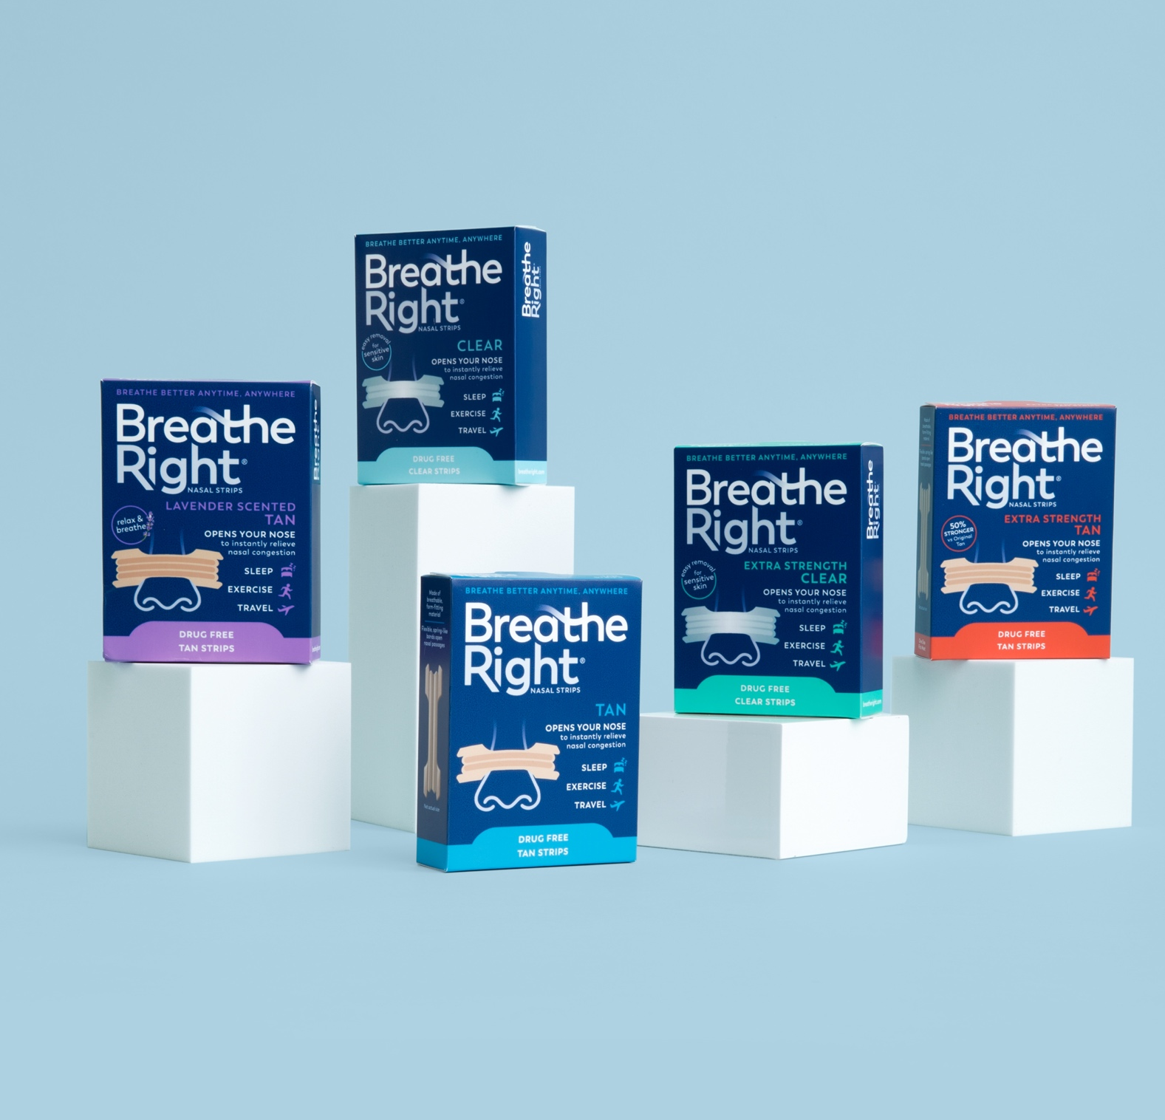

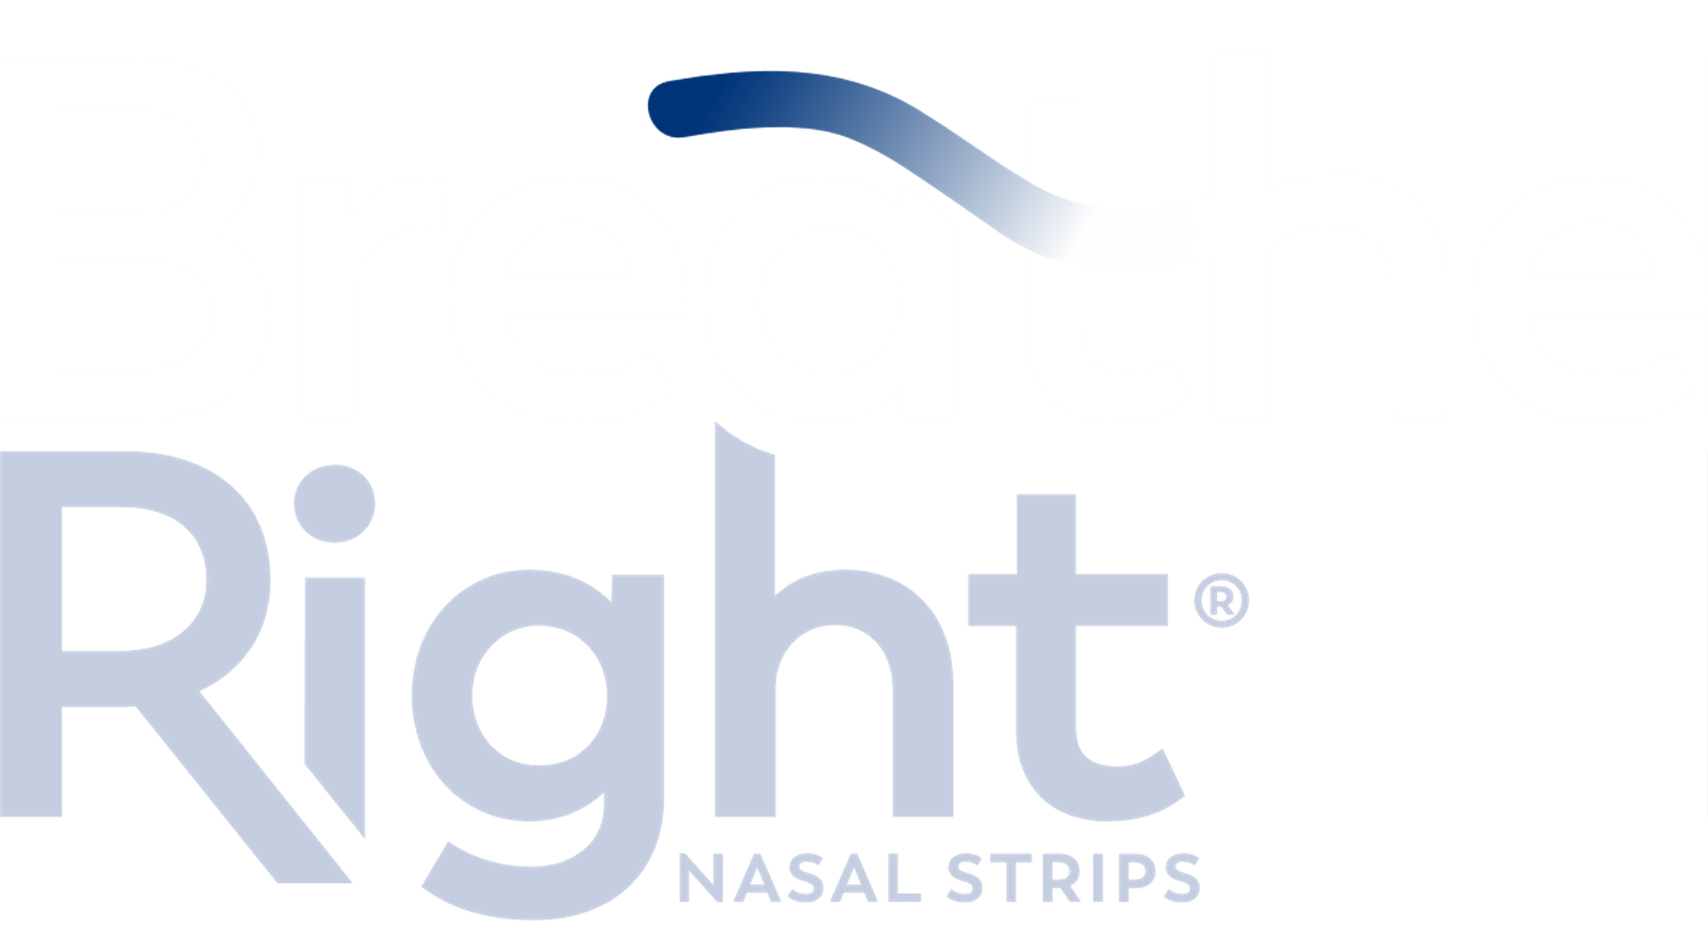
BREATHE RIGHT
Overview
December 2025
CONFIDENTIAL

Slide 2

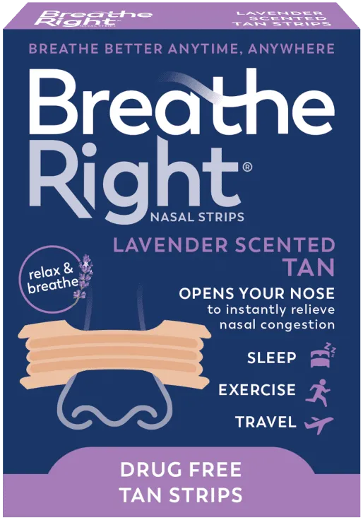
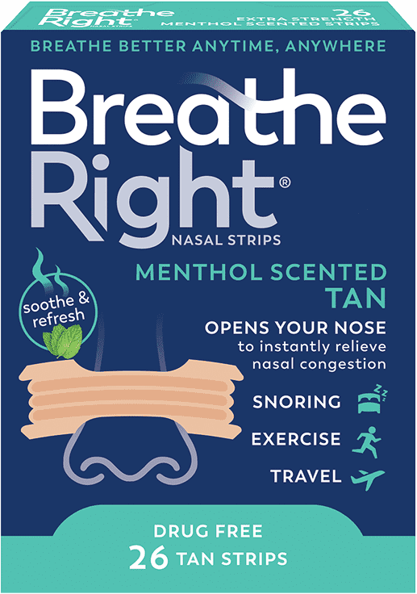
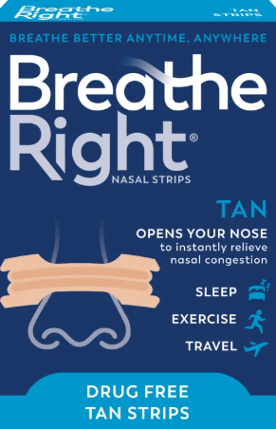
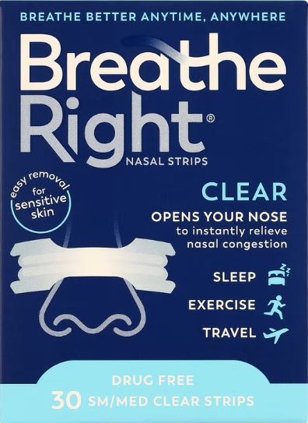
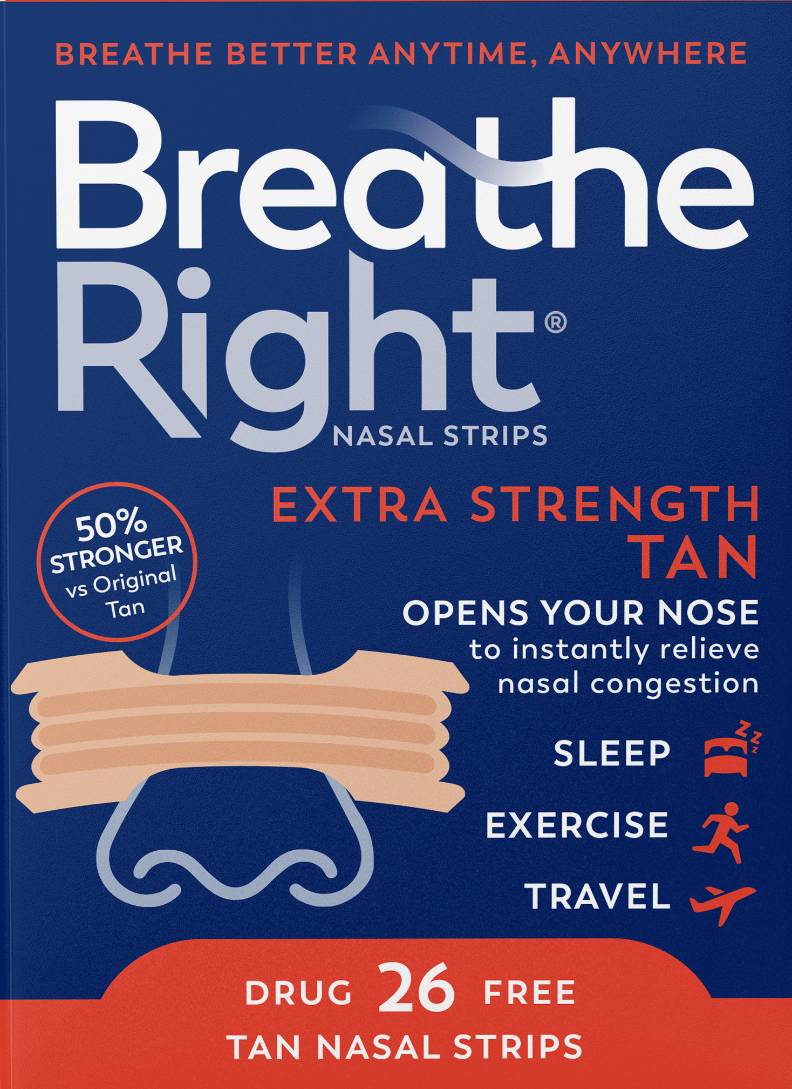
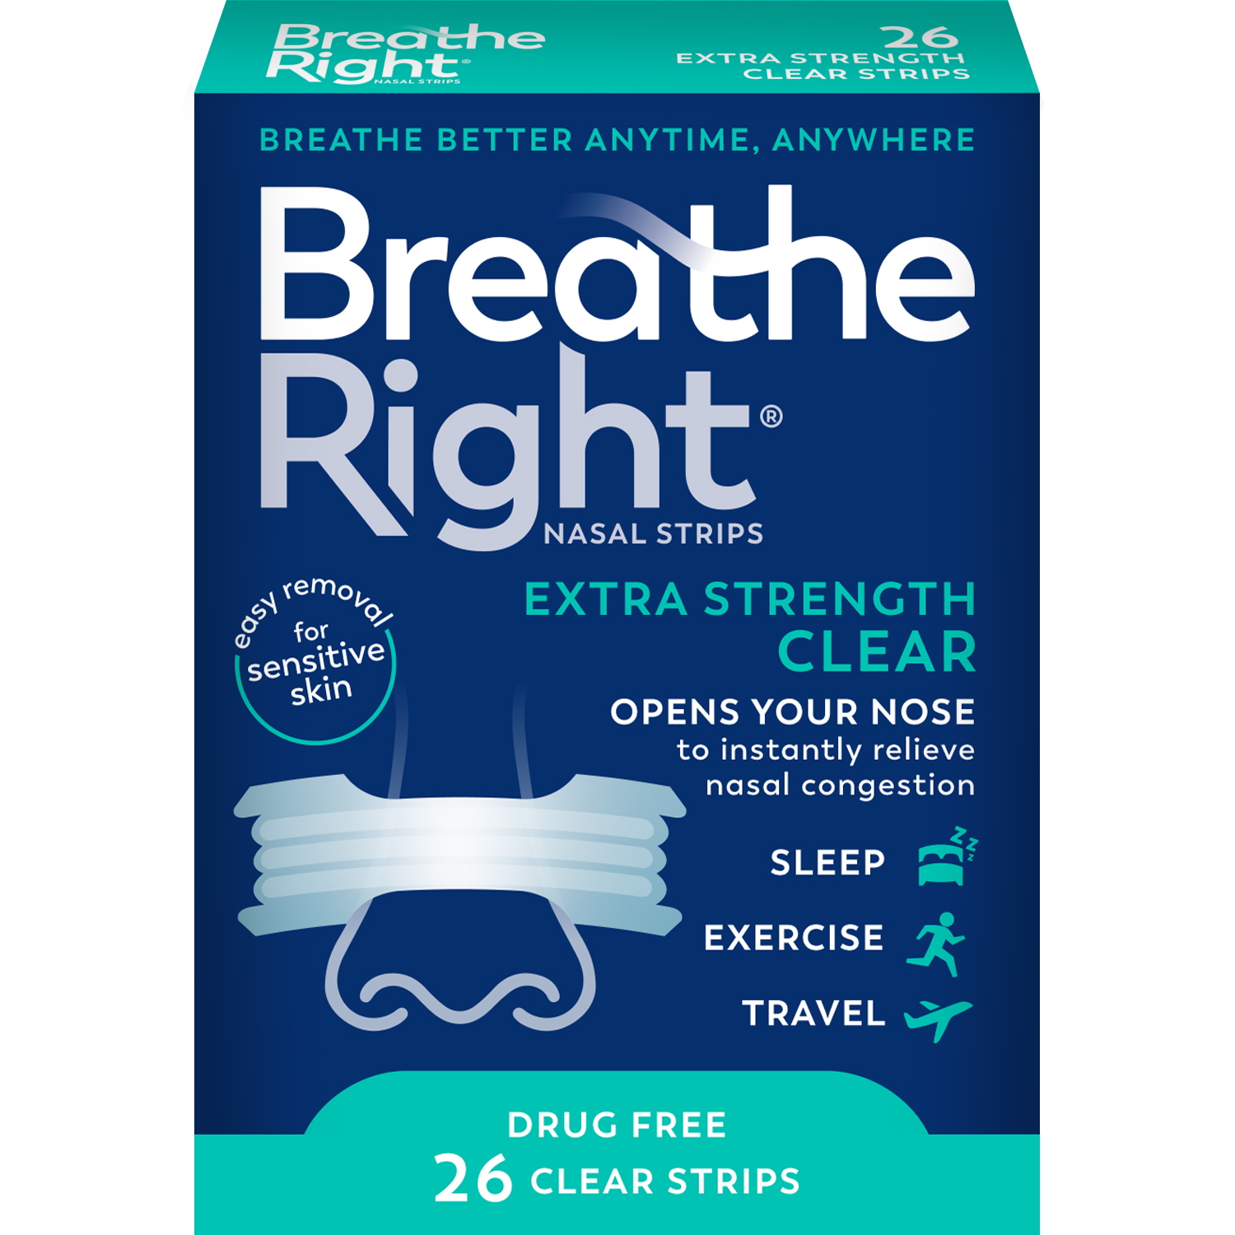
BRAND OVERVIEW
Rare Opportunity to Partner with Category-Leading Global Brand
CONFIDENTIAL

Slide 3

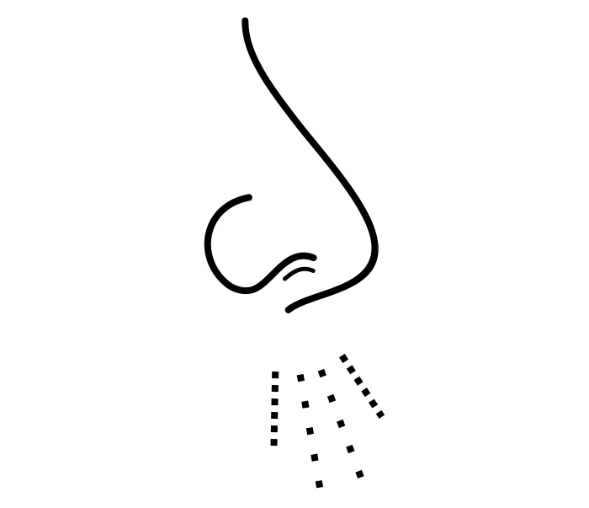








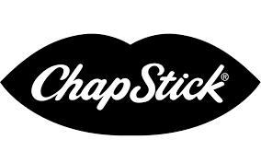
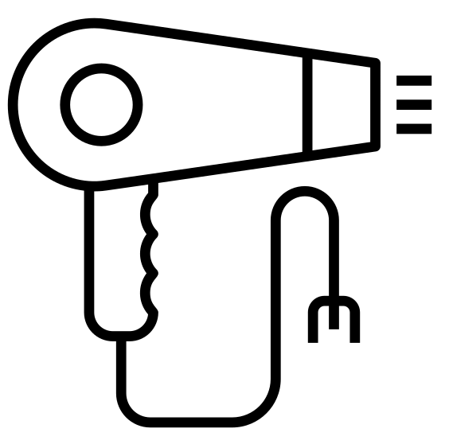

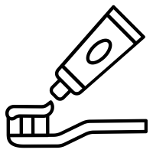


Breathe Right is Synonymous with Better Breathing
Few Categories are Defined by a Single Brand
Breathe Right is the #1 Brand Among Consumers
Nasal Strips
Emergency Contraception
First Aid
Facial Tissue
64%
Market
Share¹
Lip Care
Hair Care
None
Nail Care
None
Oral Care
None
Pain Relief
None
Breathe Right is the clear market leader
92% aided awareness, 53% unaided awareness²
Skin Care
None
VMS
None
Deodorant
None
2025 Volume share
ATU Study
CONFIDENTIAL

Slide 4



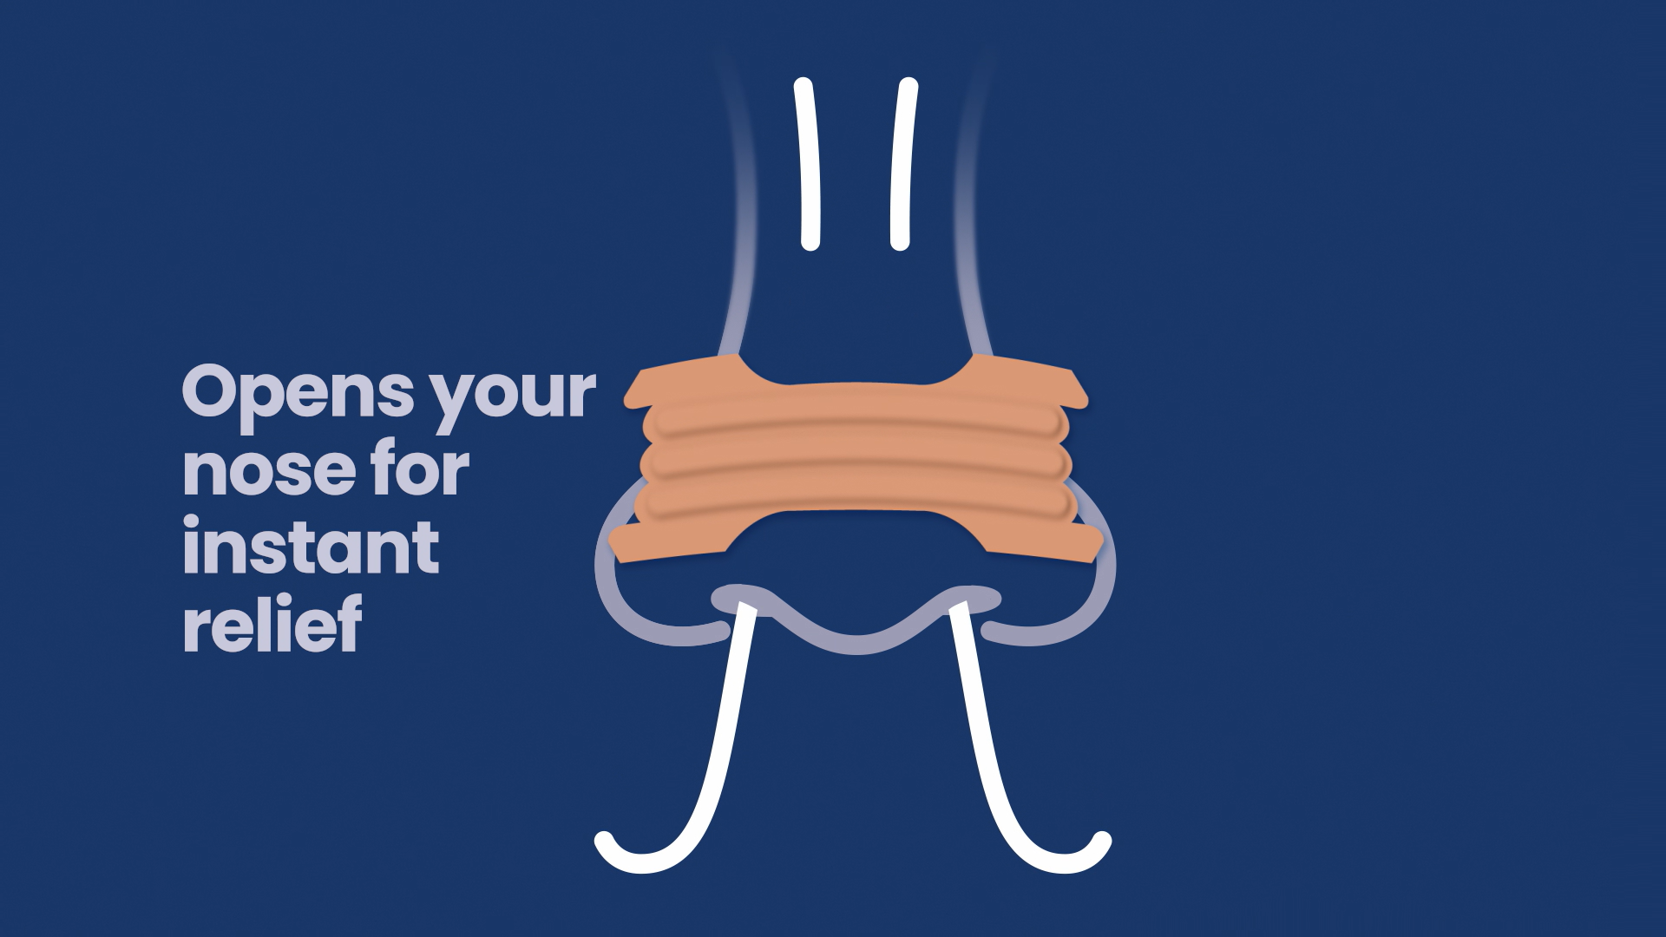
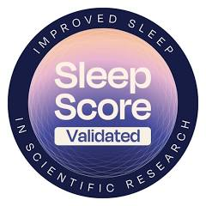


Simple Physics, Powerful Claims
Gently Lifts and Opens the Nose to Increase Nasal Airflow
Breathe Better, Sleep Better. Anytime, Anywhere.
For Nasal Congestion Relief
Increases Airflow by Up to 31%¹ for Instant Nasal Congestion Relief
Up to 12 Hours of Continuous Relief
Helps You Breathe More Comfortably
100% Drug-Free
80% of Breathe Right Consumers Reported Relief from Nighttime Nasal Congestion²
79% of Breathe Right Consumers Reported Sleeping Better²
Proprietary Material Technology
The Only Nasal Strip that Uses 3M Adhesive
Seto-Poon (1999)
2025 SleepScore Lab study
CONFIDENTIAL

Slide 5
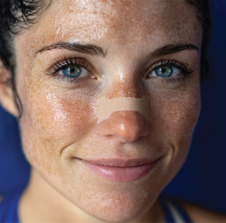


Breathe Right is the Better Breathing Authority with Accelerating U.S. & International Growth
Double-Digit Growth in Both US and International (Europe & APAC)
International
U.S.
19%
’23 –’25E
CAGR¹
10%
’23 –’25E
CAGR¹
The Wellness-Enhancing Magic
of Better Breathing
Source: Trident strategy materials, Numerator, Circana IRI
2023-L52W ended 10/5/25 unit sales CAGR
2025E Net Sales
Insert source
Circana US retail $ sales
CONFIDENTIAL

Slide 6
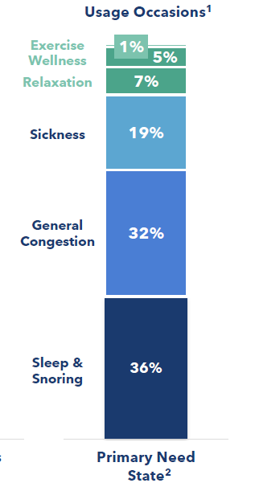
Product Portfolio Serving Distinct Consumer Needs
Breathe Right Tan: Consumers say Stays on Better, Longer
Usage Occasions Span Multiple Consumer Needs and Categories
Original
Extra Strength
Lavender
Menthol
51%
Sales³
Original & Most
Popular
50% Stronger – Made to Stay Put
With Calming Scent for Nighttime
Refreshing Scent & Cooling Effect
Breathe Right Clear: Better for Sensitive Skin, Easy to Remove
Original
Extra Strength
49%
Sales³
Hypoallergenic for Sensitive Skin, Almost Unnoticeable
50% Stronger vs. Clear, Easier on Skin, Almost Unnoticeable
~87% of Households Exclusively Buy Tan or Clear⁴
Source: Numerator, SleepScore Labs
Breathe Right share of main users by primary need states
Customer Response to question, “Why do you use nasal strips?”
2025E Gross Sales, includes club packs
Percent of households that exclusively purchase Breathe Right Tan or Clear products, L52W period ending 8/17/25
CONFIDENTIAL

Slide 7
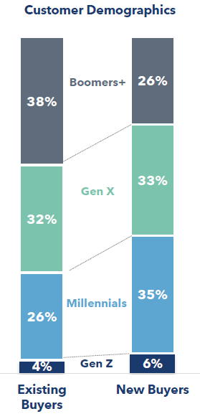




Growing with New, Younger Consumers who Prioritize Wellness
Demographics¹
Target Consumer
 | Attribute: Fit, planners, tech adopters Age: 18-35 They love trying new products to increase their overall wellness Breathe Right is their new WOW thing – the unexpected unlock in their wellness routine
 | Attribute: Active, social, food-conscious Age: 35-49 They are actively unsatisfied with other OTC options and are looking for a change Breathe Right is instant relief that WORKS – so they will keep coming back
Wellness-Driven Innovators
Male
Female
Age
55+
Age
35-54
Frustrated Sufferers
Age
18-34
`
~50%
of Consumers Use
150+ Strips a Year²
Power Users (50% of Users) Remain Highly Engaged with the Category for Years to Come
Respondents who have purchased the brand in the last 12 months (N=543)
Usage more than once a day, once a day, or several times a week (N=242)
CONFIDENTIAL

Slide 8

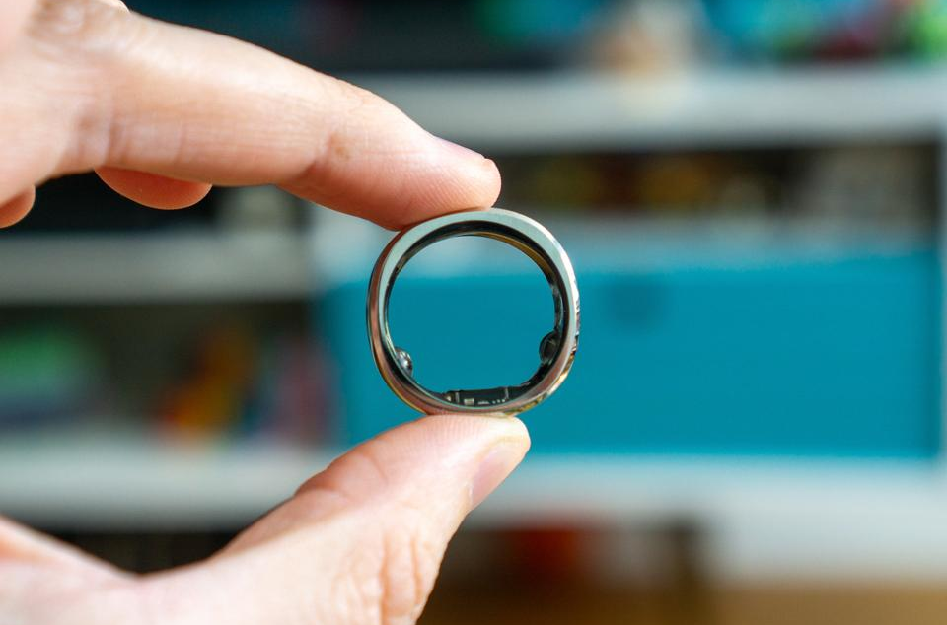
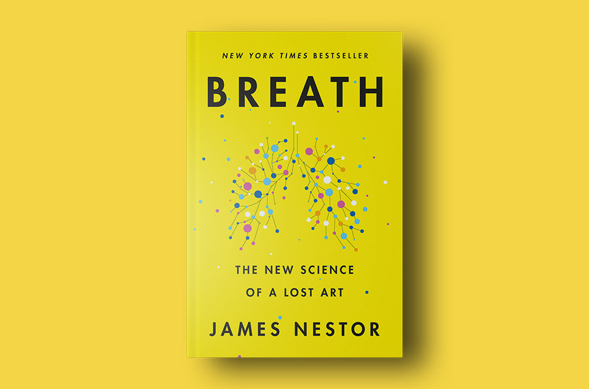

Breathe Right is Capitalizing on Long-Term Consumer Megatrends
Other Key Trends
87% of consumers feel they are not meeting their current wellness goals.
Consumers are increasingly open to trying new products that address their key needs
Younger generations are more focused on wellness, with 28% of Gen Z-ers prioritizing wellness “a lot more now”
Younger consumers over-index on spending and are more open to experimentation
Nasal Congestion Relief for Wellness
Wearables / Patches
Nasal Breathing
for Nasal Congestion Sufferers
Drug-Free
Observation
84% of consumers are making wellness a top priority, with a focus on sleep and fitness
56% of consumers are prioritizing wellness more than last year
44% of Americans own a wearable health-tracking device
Over 60% of Gen Z report using pimple patches regularly
Searches for Nasal Breathing increased 2x over the past 5 years
62% of consumers are using alternative or complementary drug-free solutions
Strategy
Growing Addressable
Audience and Market
Focus on Health Optimization and Comfort with Wearable Devices
Uniquely Positioned to Deliver on Growing Need
Products Aligned to
Drug-Free Trend
Source: McKinsey & Company, Google Trends
CONFIDENTIAL

Slide 9
THANK YOU!
CONFIDENTIAL

