Slide 1
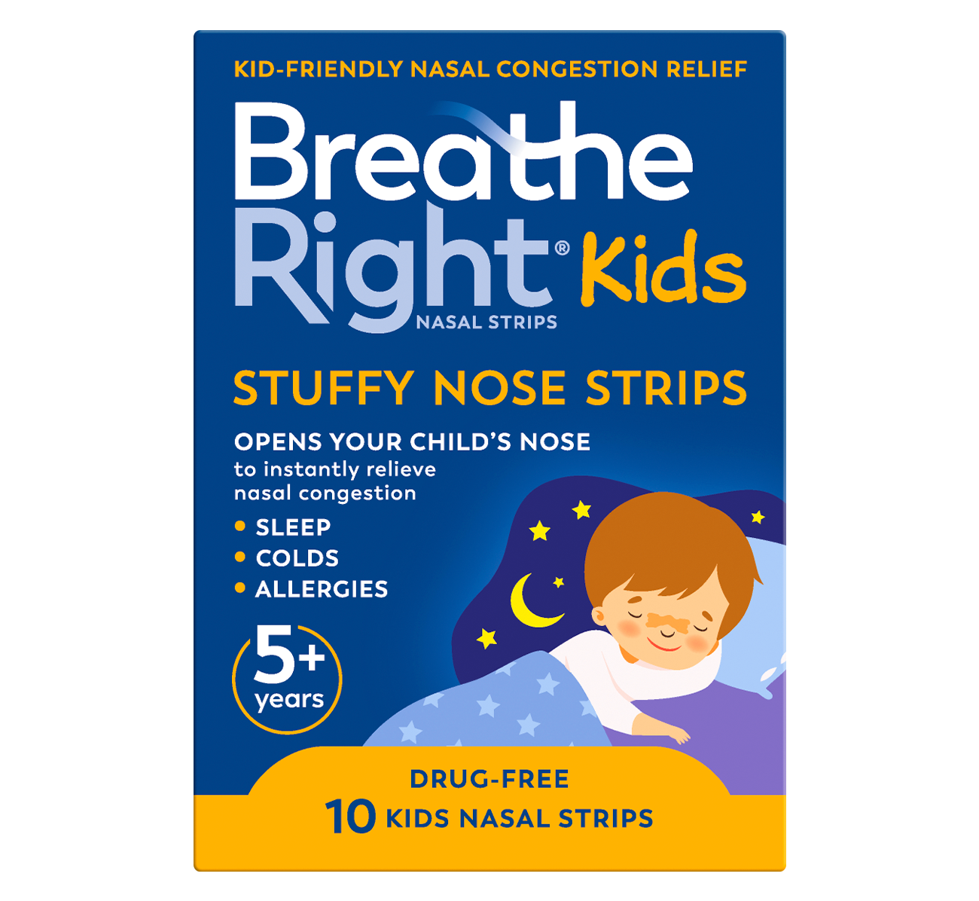
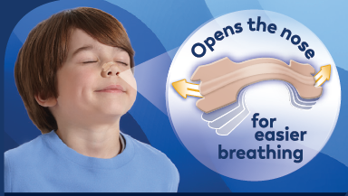
Images
Lifestyle: Strip on a Kids face – can we use the image on the back of the artwork?
How to apply – see next slide
Strip Size - see next slide
Usp’s - see slide 3
Open’s your nose – see next slide

Slide 2
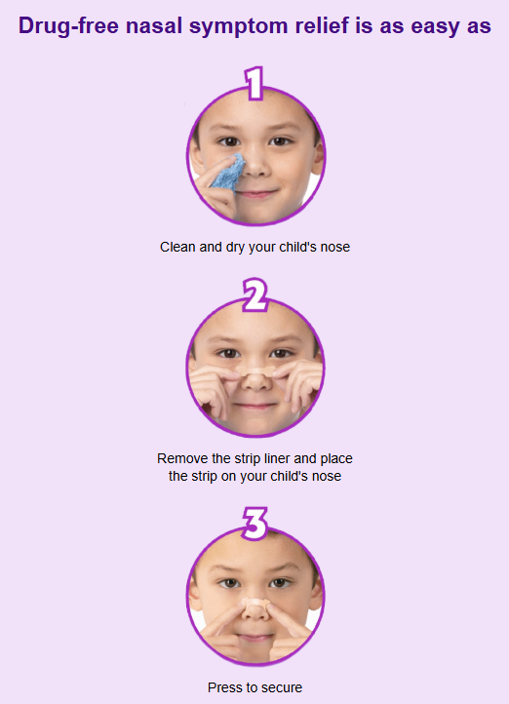
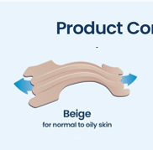
How to apply
Use an illustration like the front of pack or stock photos of a child.
Strip size and colour
Similar to the product comparison layout
Can you make this into an image?
With a breathable and form‑fitting hypoallergenic material
Safe for children 5+ years old

Slide 3



Use blue/Yellow tone matching the pack.
3M - Exclusively designed with trusted 3M medical-grade adhesive/ trusted 3M medical-grade adhesive
Safe for children 5+ years
3. Dermatologically tested
4. 100% Drug-Free
Exclusively designed with trusted 3M medical-grade adhesive,
100% Drug-Free

